Slide 1
Overview of Key Clinical Considerations
MTN 025 Training

Slide 2
Outline
Baseline Medical/Menstrual History
Concomitant Medications
PrEP Considerations
Physical Exams
Pelvic Exams
Contraceptive Counseling
PSRT

Slide 3
Baseline Medical/Menstrual History
Initially collected and documented at Screening
Actively reviewed and updated at Enrollment
Purpose of this information
  Assess and document eligibility
  Assess and document baseline conditions for comparison in follow-up. This directly impacts AE reporting

Slide 4
Tips for Obtaining a Complete History
Clinicians should use their clinical judgement to determine the best approach to elicit pertinent information
Tools
  MTN-025 Baseline Medical History Questions sheet
  Baseline Medical History Log CRF
  HOPE Safety Lab Calculator
Goal
  All relevant baseline conditions are listed on the Baseline Medical History Log CRF

Slide 5
  Baseline Medical History Questions sheet

Slide 6
  Baseline Medical History Questions sheet

Slide 7
Baseline Medical History Questions Sheet
“Relevant baseline condition”
  Hospitalizations
  Surgeries
  Allergies
  Conditions requiring prescription or chronic medication (>2 weeks)
  Any conditions currently experienced by the participant

Slide 8
Documenting on the Baseline Medical History Log
Identified conditions are collected on the Baseline Medical History Log CRF
  Description of event
  Is the condition gradable
  Severity grade (FGGT or version 2.0)
  Date condition started
  Is the condition ongoing
  Date the condition ended
  Comments
Record as much information as possible about severity and frequency in the comments

Slide 9
Baseline Medical History Log
In addition to participant-reported conditions, record the following on the Baseline Medical History Log:
  Grade 1 and higher lab values
  Medically-relevant physical exam abnormalities
  Pelvic exam abnormal findings
  Any identified STIs

Slide 10
Hints for the Baseline Medical History Log
Recurrent chronic conditions should be marked as ‘ongoing’ at enrollment (e.g., headaches)
For severity, use the highest severity experienced for the condition
Not gradable events include ongoing menorrhagia, metrorrhagia, and menometrorrhagia
Infrequent bleeding should be captured using the terms “missed menses”, “oligomenorrhea” or “amenorrhea” as appropriate (if unexplainable per the tox table)
Anaphylactic reactions should be captured as “allergic reaction to…”

Slide 11
Updating the Baseline Medical History
At Enrollment, each baseline medical condition entry should be reviewed, updated as needed, and the status for ‘ongoing at enrollment’ should be reviewed

Slide 12
HOPE Safety Lab Calculator
The Safety Lab Calculator is a tool for quickly determining thresholds of adverse events for each participant
Updated from the ASPIRE tool to reflect current DAIDS Toxicity Table
Enter site-specific Upper Limits of Normal, or participant-specific values, as indicated
Print and maintain in the participant binder

Slide 13
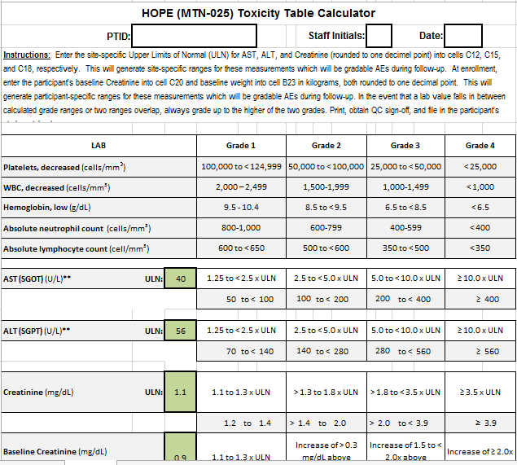
HOPE Safety Lab Calculator

Slide 14
Concomitant Medications
All medications taken by study participants from Screening through follow-up must be documented
Con med CRF completed at Screening and entries are added as needed
These include
  Prescriptions
  Over the counter
  PrEP and PEP
  Vaccinations
  Supplements
  Contraception
  Herbal, naturopathic and traditional preparations
These DO NOT include
  Alcohol
  Recreational drugs

Slide 15
Conmed Hints
Use information from medical history to probe for medications
Record the trade name if possible
If the exact name is unknown, record the type of medication

Slide 16
PrEP
Per protocol, oral tenofovir-based ARV use is permitted if approved, available, and provided to participants by a health care provider as PrEP
PrEP use should be documented as a concomitant medication
HOPE trial participants will be encouraged to consider any and all HIV prevention tools available to them
If national guidelines and local standard of care support PrEP, sites are encouraged to consider making PrEP available on-site
Each site will have a PrEP SOPs (training, counseling, provision, and referrals)
  These SOPS should be routinely reviewed and updated

Slide 17
Prohibited Medications and Devices
Contraceptive vaginal rings are the only prohibited medication in MTN-025 (inform PSRT)
Concomitant use of devices such as diaphragms, menstrual cups, and cervical caps, will be discouraged.
NOTE: Products and practices including the use of spermicides, vaginally applied medication, douches, lubricants, tampons, etc., are permitted in MTN-025.

Slide 18
Physical and Pelvic Exams

Slide 19
Physical Exam
Required at:
  Screening (complete)
  Enrollment (abbreviated)
  PUEV (abbreviated)
Conduct at any other visit if clinically indicated
Physical Exam CRF is recommended source document

Slide 20

Physical Exam
Vital signs
  Height
  Weight
  Oral temperature
  Blood pressure
  Pulse
  Respirations
Clinical assessments of
  General Appearance
  Lymph nodes
  Neck
  Heart
  Lungs
  Abdomen
  Extremities
  Neurological
  Skin
Other assessments at discretion of examining clinician
Notes:
Complete physical exam will be conducted at screening visit and a targeted physical exam for all subsequent scheduled visits.
Bolded and underlined components are required at follow up

Slide 21
Physical Exam Documentation
At Screening and Enrollment, note medically relevant abnormal findings on Baseline Medication History Log
Abnormal physical exam findings newly identified during follow-up are recorded and tracked using the Adverse Experience Log (AE) CRF or Grade 1 Adverse Experience Log (GAE) CRF

Slide 22
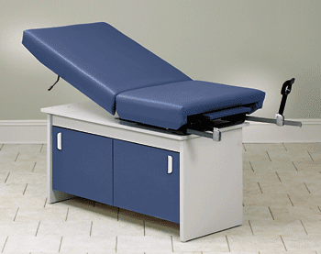
Pelvic Exam
  Pay careful attention to which evaluations are required at all exams, which are required at some but not all exams, and which are required only when clinically indicated

Slide 23
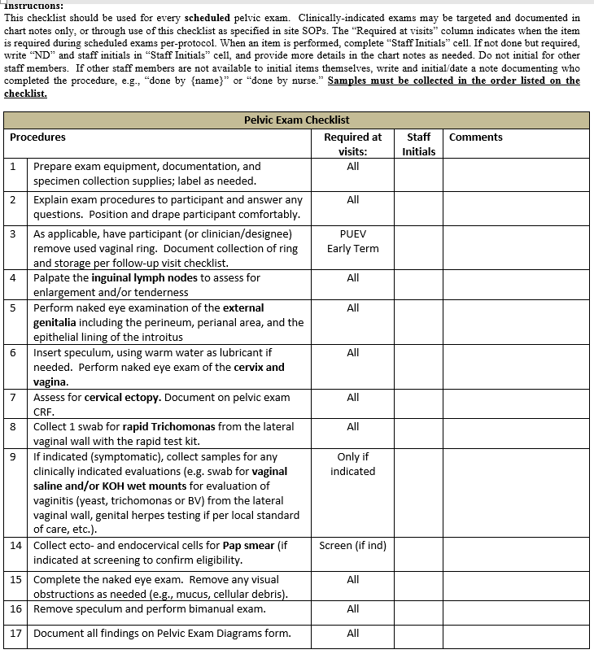
Pelvic Exam
Checklist

Slide 24
Pelvic Exam at Screening
Screening visit pelvic exams are documented on the Pelvic Exam Diagram form and the Pelvic exam CRF
Any abnormal pelvic findings should be documented on the Baseline Medical History Log
Only grade 1 or 2 findings may be ongoing at enrollment

Slide 25
Pelvic Exam at Enrollment
Pelvic exam is not required at the Enrollment visit
If an exclusionary finding is found at screening, it will be necessary to re-assess prior to Enrollment
  Document re-assessment by completing a new Pelvic Exam Diagram form and updating the severity grade, ongoing status and other info on the Baseline Medical History Log entry
  If re-assessment is done at the Enrollment visit, document the abnormal finding status on a new Pelvic Exam CRF (added to enrollment visit in Medidata by clicking “additional study procedures”)

Slide 26
Pelvic Exam in Follow-Up
Follow-up pelvic exams are required at the PUEV visit and when clinically indicated
  Definitely recommended when new GU complaints are present
  If new symptoms have resolved by the time of the visit, the utility of an exam is per clinician discretion
Participants may decline an exam
  If ppt declines, a second attempt should be made

Slide 27
Pelvic Exam
Two person team: examining clinician and assistant
Ensure all possibly-required supplies and paperwork are easily accessible in exam room
Review specimen collection requirements for each visit in preparation for each exam
Pay careful attention to the required sequence of swab collection and required handling of each swab

Slide 28
Pelvic Exam - Unique Considerations
Exams during bleeding:
  Complete regardless of genital bleeding unless there is heavy bleeding and/or the participant is uncomfortable. If not done, complete as part of split visit or make up at next visit.
Exams during pregnancy:
  Per protocol, continue exams up to 24 weeks of gestation. While not required, it is considered safe to continue exams after 24 weeks of gestation.
Exams for Participants with Hysterectomy:
  Eligible for enrollment; modify procedures for Pap smear and cervical ectopy assessment

Slide 29
Pelvic Exam Documentation
ALL findings (normal and abnormal) should be documented using the Pelvic Exam Diagrams form
All abnormal findings during screening will be documented on the Pelvic Exam CRF and the Baseline Medical History Log CRF
Normal variants
  Anatomic variants
  Gland Openings
  Mucus retention cysts
  Gartner’s duct cysts
  Scars
  Nabothian cysts
  Skin tags
  Cervical ectopy

Slide 30
Pap Smears at Baseline
Required at Screening unless documented normal result available within 12 months
If inadequate specimen is collected, a second (repeat) Pap specimen must be collected and tested prior to Enrollment in order to assess eligibility
Grade 1 or 2 Pap results are not exclusionary, however, if further evaluation is required (i.e. colposcopy and/or biopsy) per site SOPs, this should be scheduled as appropriate during study follow-up.
Record abnormal results during screening on baseline medical history log

Slide 31
STI/RTI/UTIs – Baseline Considerations
STI/RTI/UTI requiring treatment may be enrolled after treatment is complete provided all symptoms have resolved
Treat per SOC and applicable SOPs
Test of cure for STI/RTI/UTIs after treatment is NOT required before a participant is enrolled
See SSP Section 10.5.1 for specific STI considerations during S&E

Slide 32
Contraceptive Use in HOPE
To be eligible for MTN-025, potential participants must report use of an effective method of contraception at enrollment and intent to use an effective method for the duration of the study
Effective methods: hormonal methods, IUDs, sterilization of ppt
To optimize access, all sites should provide as many methods as possible to study participants on site.
All sites should offer emergency contraception

Slide 33
Contraceptive Counseling
Counseling is required at all scheduled study visits
Counseling should be in accordance with local counseling standards, site-specific SOPs, and World Health Organization (WHO) guidance
Counselling should be
  Client centered
  Include standard information about mechanism of action, side effects, level of effectiveness
Women may choose to discontinue contraception in follow-up

Slide 34
Month 3 Contraceptive Counseling Considerations
At month 3, study staff should pay attention to the contraceptive method the participant is using when her next dose is due.
Important to discuss what to do in the case of a suspected pregnancy in between study visits
  Ppt should contact the study clinic
  Staff should reassure participants that continued product use is ok until pregnancy test is positive

Slide 35
PSRT and Layers of Safety
Study participants
Study site staff team
Clinical affairs staff at SCHARP
Protocol Safety Review Team (PSRT)
MTN Study Monitoring Committee (SMC)
Notes:
Note to presenter: best to go through remaining slides rather quickly. Take home point: there are many layers to safety monitoring, all important. Focus on PSRT query process and where to find query form.

Slide 36
Protocol Safety Review Team
Meets monthly or as required
Safety and adverse event data are reviewed
Discussion of safety issues

Slide 37
Examples of PSRT Queries
Protocol specific notifications
  For example, site is unable to retrieve study product within protocol specified time period
Protocol specific clinical direction
  For example, superficial epithelial disruption which worsens after 3-5 days
Questions that are not addressed in the protocol
  Eligibility questions
  AE documentation questions
  Clinically challenging management cases

Slide 38
PSRT Query Process
Site submits query
PSPs draft response
PSRT comments
PSPs finalize response
Response back to site
Email to (mtn025safetymd@mtnstopshiv.org)
<72 hours
Notes:
38

